Slide 1


Detection and Classification of Emergency Sirens in Traffic
Audio Technology ESA
Project
Number of Credits: 2
Date: 13/07/2023
Notes:
1

Slide 2
Team Composition
Sumukh S | PES1UG21EC302
Sushanth M G | PES1UG21EC305
V Shankar | PES1UG21EC318
Guide : Dr. Ashwini (ECE)
Notes:
2

Slide 3
Contents
Introduction
Problem Statement
Literature Survey
Methodology
Software Used
Results and Comparison
References
Acknowledgement
Notes:
3

Slide 4

Introduction
Machine Learning Models Used
Convolutional Neural Networks
Support Vector Machines
Random Forests
XGBoost
AdaBoost
Long Short Term Memory
Notes:
4

Slide 5
Introduction
Features Extracted From Audio Dataset
Mel Frequency Cepstral Coefficients
Root Mean Square Energy
Zero Crossing Rate
Spectral Bandwidth
Spectral Centroid
Chroma Features
Notes:
5

Slide 6
Problem Statement
Develop an efficient and accurate system for audio detection and classification of emergency sirens from traffic noise to enhance road safety and emergency response to civil distress.
Notes:
6

Slide 7
Literature Survey
[1] Asif M, Usaid M, Rashid M, Large-scale audio dataset for emergency vehicle sirens and road noises, Sci Data 9, 599 (2022).
[2] Mittal U, Chawla P, Acoustic Based Emergency Vehicle Detection Using Ensemble of Deep Learning Models. Procedia Comput. Sci. 2023, 218, 227–234.
[3] Suhaimy, M. A., Halim, I. S. A., Hassan, S. L. M., and Saparon, A. (2020, December). Classification of ambulance siren sounds with MFCC SVM. AIP Conference Proceedings (Vol. 2306, No. 1, p. 020032). AIP Publishing LLC.
Notes:
7

Slide 8

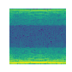
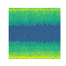

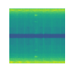
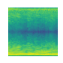
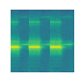
Methodology
Sample audio .wav files from the dataset along with spectrogram .png images:
Ambulance | Firetruck | Traffic | Police | Weather (or Civil Defense) | Fire Alarm
Notes:
8

Slide 9
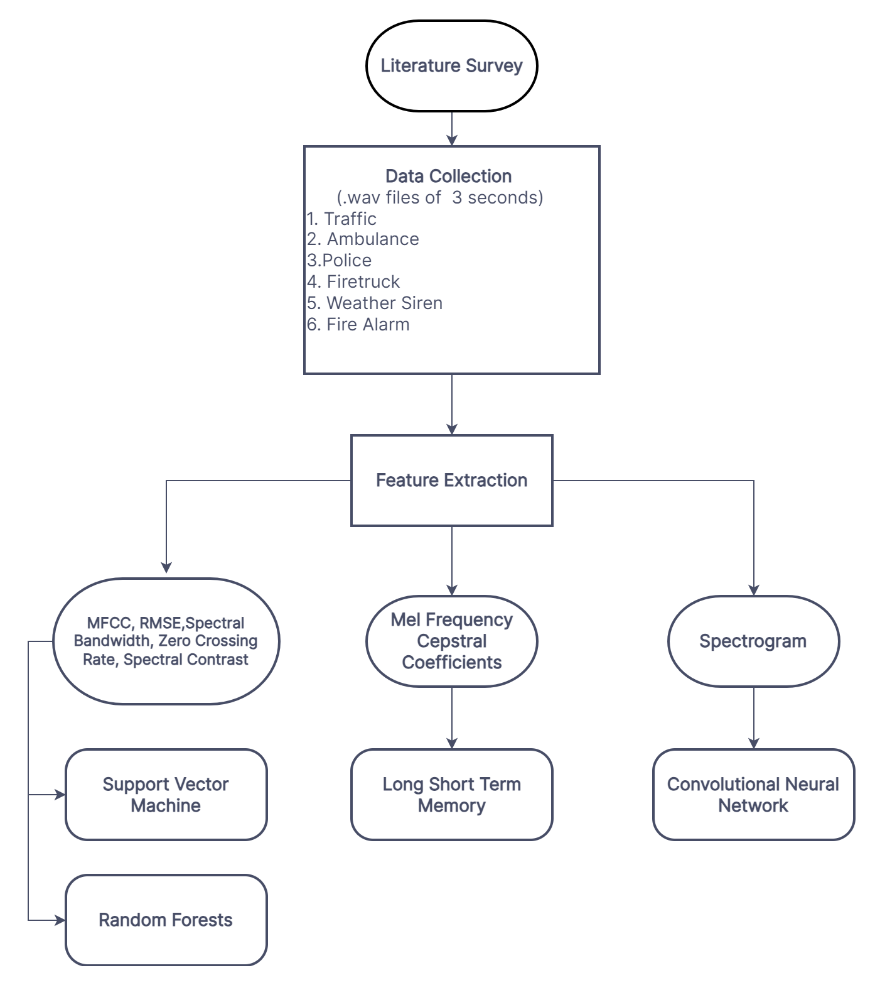
Methodology
Notes:
9

Slide 10







Software Used
Python
Google Collaboratory
Numpy
Pandas
Matplotlib
Scikitlearn
Librosa
Seaborn
Torch
Pytorch Lightning
PIL (Python Imaging Library)
Scipy
Tensorflow
Keras
Pickle
AudioSet
FFMPEG
Youtube-DL
Notes:
10

Slide 11
Results and Comparison
Convolutional Neural Network:
Accuracy: 93.49%
 | Precision | Recall | F1-Score | Support
Ambulance | 0.7826 | 1.0000 | 0.8780 | 36
Firetruck | 0.8780 | 1.0000 | 0.9351 | 36
Traffic | 1.0000 | 0.8857 | 0.9394 | 35
Police | 0.9796 | 1.0000 | 0.9897 | 48
Tornado | 1.0000 | 0.7447 | 0.8537 | 47
Fire_Alarm | 1.0000 | 1.0000 | 1.0000 | 44
Macro Avg | 0.9400 | 0.9384 | 0.9326 | 246
Weighted Avg | 0.9464 | 0.9350 | 0.9341 | 246
Notes:
11

Slide 12
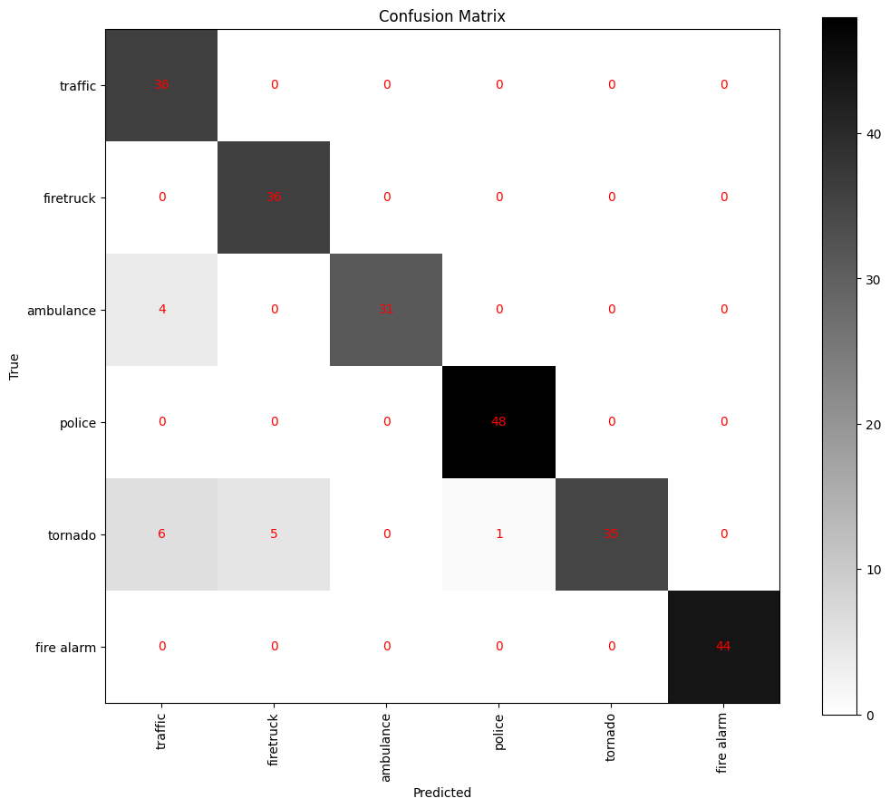
Results and Comparison
Notes:
12

Slide 13
Results and Comparison
Long Short Term Memory:
Accuracy: 94.31%
 | Precision | Recall | F1-Score | Support
Ambulance | 0.9300 | 0.9700 | 0.9500 | 40
Firetruck | 0.9600 | 0.8800 | 0.8900 | 40
Traffic | 1.0000 | 0.9700 | 0.9900 | 40
Police | 0.9600 | 0.9800 | 0.9700 | 46
Tornado | 0.8900 | 0.8500 | 0.8700 | 40
Fire_Alarm | 0.9800 | 1.0000 | 0.9900 | 40
Macro Avg | 0.9400 | 0.9400 | 0.9400 | 246
Weighted Avg | 0.9400 | 0.9400 | 0.9400 | 246
Notes:
13

Slide 14
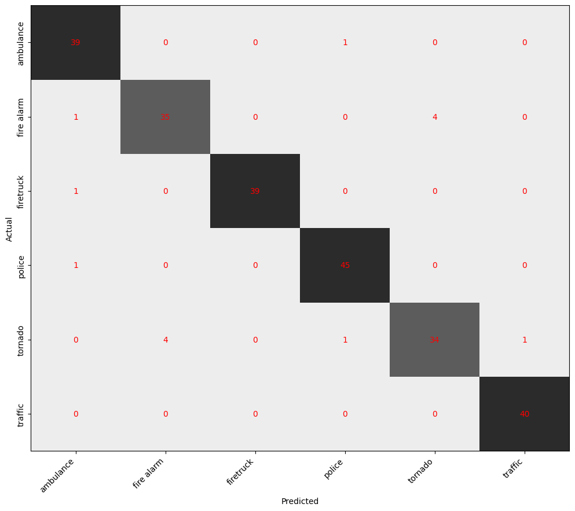
Results and Comparison
Notes:
14

Slide 15
Results and Comparison
Support Vector Machine:
Accuracy: 90.24%
 | Precision | Recall | F1-Score | Support
Ambulance | 0.7778 | 0.8750 | 0.8235 | 16
Firetruck | 0.8500 | 0.8947 | 0.8718 | 19
Traffic | 1.0000 | 0.8500 | 0.9189 | 20
Police | 0.9130 | 0.9545 | 0.9333 | 22
Tornado | 0.8750 | 0.8400 | 0.85710 | 25
Fire_Alarm | 1.0000 | 1.0000 | 1.0000 | 21
Macro Avg | 0.9026 | 0.9024 | 0.9008 | 123
Weighted Avg | 0.9070 | 0.9024 | 0.9231 | 123
Notes:
15

Slide 16
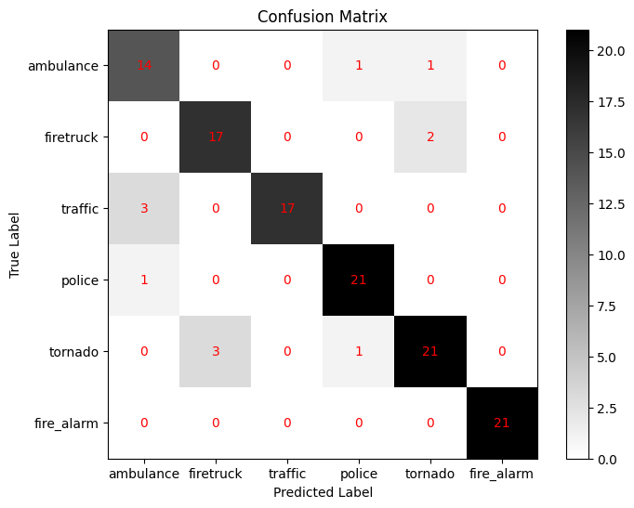
Results and Comparison
Notes:
16

Slide 17
Results and Comparison
Random Forest:
Accuracy: 87.80 %
 | Precision | Recall | F1-Score | Support
Ambulance | 1.0000 | 0.8000 | 0.8889 | 45
Firetruck | 0.9130 | 0.8182 | 0.8710 | 33
Traffic | 1.0000 | 1.0000 | 1.0000 | 33
Police | 0.9778 | 0.9362 | 0.9565 | 47
Tornado | 0.9750 | 0.8667 | 0.9176 | 45
Fire_Alarm | 1.0000 | 0.8605 | 0.9250 | 43
Macro Avg | 0.9806 | 0.8702 | 0.9265 | 246
Weighted Avg | 0.8780 | 0.8780 | 0.8780 | 246
Notes:
17

Slide 18
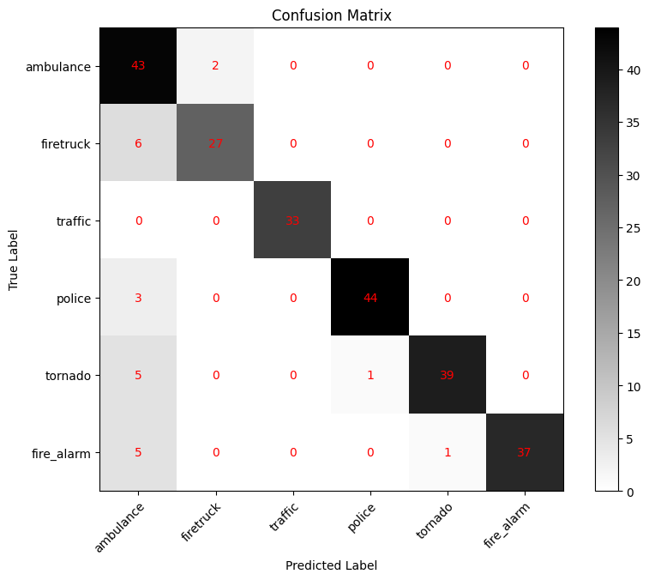
Results and Comparison
Notes:
18

Slide 19
Results and Comparison
XGBoost:
Accuracy: 89.02%
 | Precision | Recall | F1-Score | Support
Ambulance | 0.9200 | 0.7800 | 0.8400 | 45
Firetruck | 0.9400 | 0.9400 | 0.9400 | 33
Traffic | 0.9700 | 1.0000 | 0.9900 | 33
Police | 0.9400 | 0.9400 | 0.9400 | 47
Tornado | 1.0000 | 08700 | 0.9300 | 45
Fire_Alarm | 0.9700 | 0.9100 | 0.9400 | 43
Macro Avg | 0.9600 | 0.9000 | 0.9300 | 246
Weighted Avg | 0.8900 | 0.9000 | 0.9000 | 246
Notes:
19

Slide 20
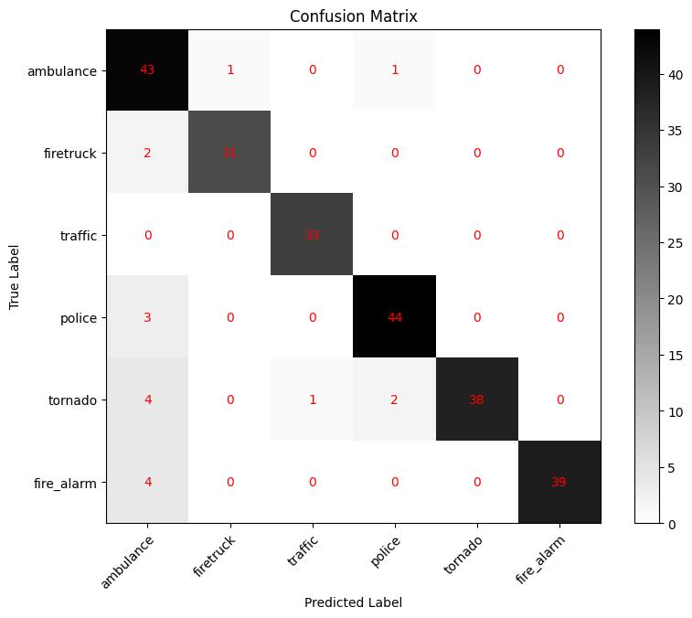
Results and Comparison
Notes:
20

Slide 21
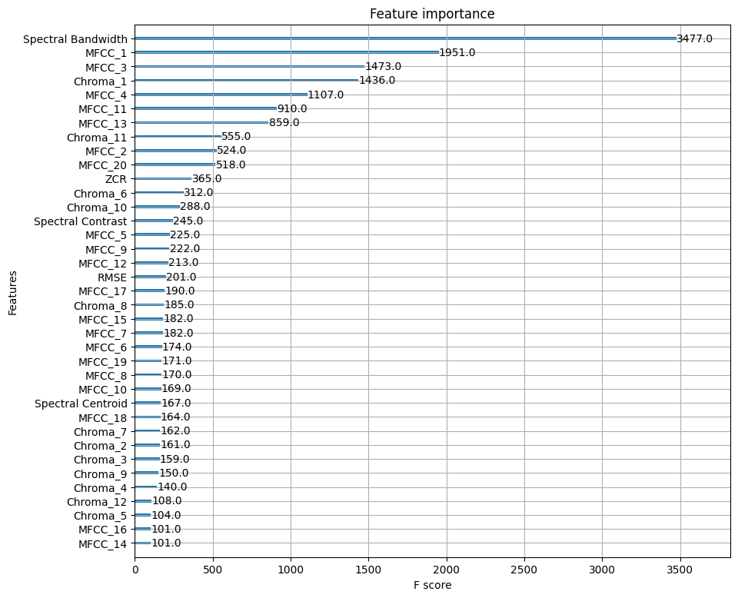
Results and Comparison
Notes:
21

Slide 22
Results and Comparison
Random Forest With Reduced Features:
Accuracy: 74.79%
 | Precision | Recall | F1-Score | Support
Ambulance | 0.9394 | 0.6889 | 0.7949 | 45
Firetruck | 0.8065 | 0.7576 | 0.8812 | 33
Traffic | 1.0000 | 1.0000 | 1.0000 | 33
Police | 0.9744 | 0.8085 | 0.8837 | 47
Tornado | 0.8750 | 0.4667 | 0.6087 | 45
Fire_Alarm | 0.9231 | 0.8372 | 0.8780 | 43
Macro Avg | 0.9197 | 0.7598 | 0.8244 | 246
Weighted Avg | 0.7480 | 0.7480 | 0.7480 | 246
Notes:
22

Slide 23
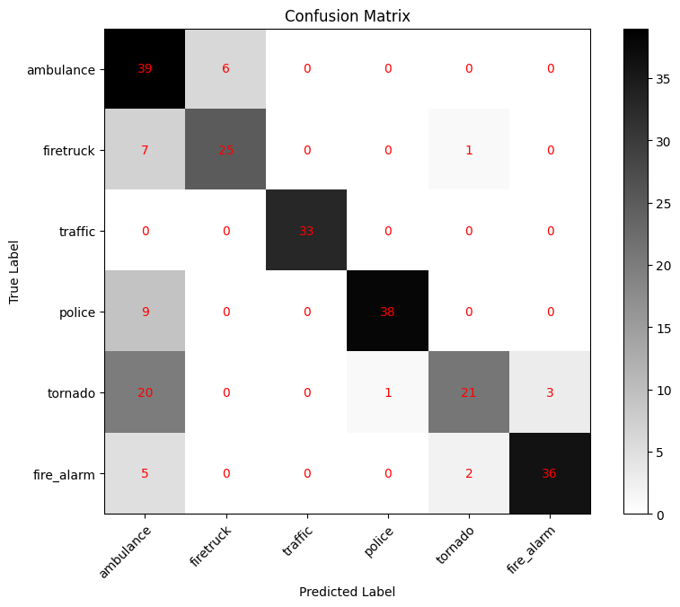
Results and Comparison
Notes:
23

Slide 24
Results and Comparison
AdaBoost: Accuracy: 85.77%
 | Precision | Recall | F1-Score | Support
Ambulance | 0.8100 | 0.8400 | 0.8300 | 45
Firetruck | 0.7300 | 0.8200 | 0.7700 | 33
Traffic | 1.0000 | 1.0000 | 1.0000 | 33
Police | 0.9100 | 0.9100 | 0.9100 | 47
Tornado | 0.8400 | 0.7100 | 0.7700 | 45
Fire_Alarm | 0.8600 | 0.8800 | 0.8700 | 43
Macro Avg | 0.8600 | 0.8600 | 0.8600 | 246
Weighted Avg | 0.8600 | 0.8600 | 0.8600 | 246
Notes:
24

Slide 25
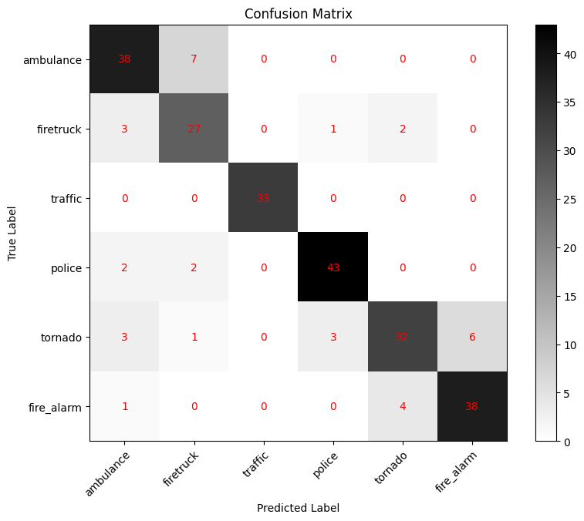
Results and Comparison
Notes:
25

Slide 26
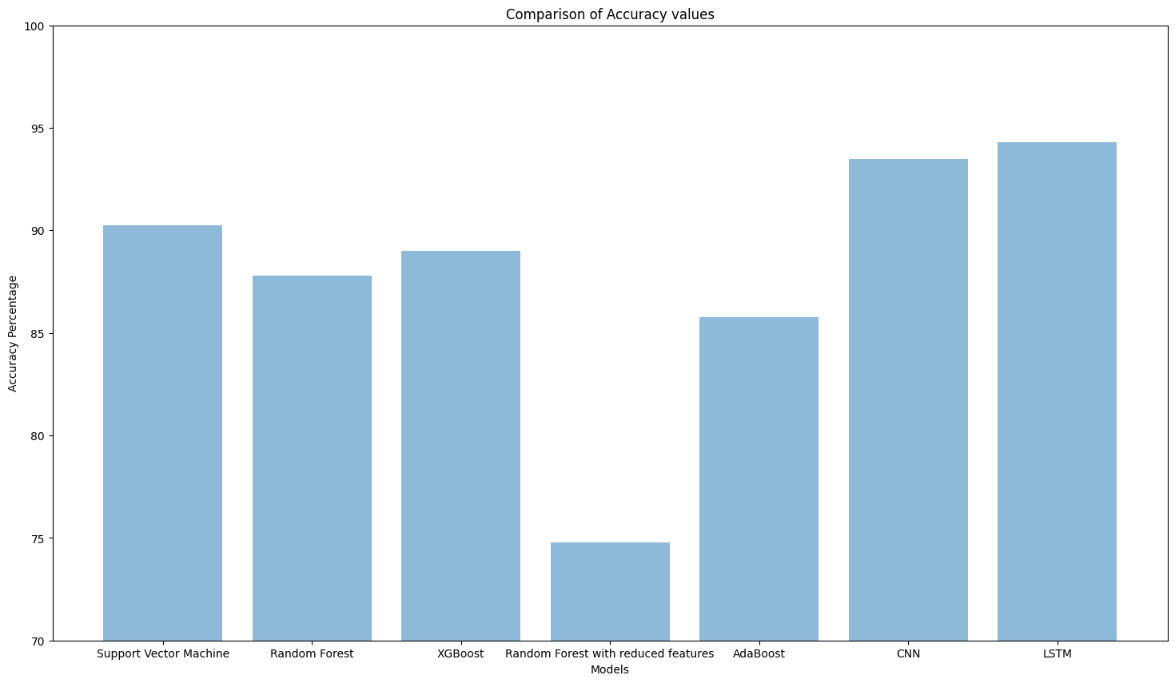
Results and Comparison
Notes:
26

Slide 27
References
[1] Asif M, Usaid M, Rashid M, Large-scale audio dataset for emergency vehicle sirens and road noises, Sci Data 9, 599 (2022).
[2] Mittal U, Chawla P, Acoustic Based Emergency Vehicle Detection Using Ensemble of Deep Learning Models. Procedia Comput. Sci. 2023, 218, 227–234.
[3] Suhaimy, M. A., Halim, I. S. A., Hassan, S. L. M., and Saparon, A. (2020, December). Classification of ambulance siren sounds with MFCC SVM. AIP Conference Proceedings (Vol. 2306, No. 1, p. 020032). AIP Publishing LLC.
[4] https://www.kaggle.com/datasets/vishnu0399/emergency-vehicle-siren-sounds
[5] https://datagy.io/python-support-vector-machines
[6] https://www.datacamp.com/tutorial/cnn-tensorflow-python
[7] https://www.alpha-quantum.com/blog/long-short-term-memory-lstm-with-python/long-short-term-memory-lstm-with-python/
[8] https://stackabuse.com/random-forest-algorithm-with-python-and-scikit-learn/
Notes:
27

Slide 28
Acknowledgement
We would like to thank Dr. Ashwini ma’am for providing us with an opportunity and guiding us in completing this project. We gained invaluable experience and knowledge which will prove useful in our future endeavors.
Notes:
28

